Slide 1
Trading Mobile Data with Controllable Privacy Loss
Presentation at IEEE MDM 2020
Presenter: Shuyuan Zheng
Authors: Shuyuan Zheng, Yang Cao, Masatoshi Yoshikawa
Affiliation: Kyoto University
Notes:
Good afternoon everyone. I am ZHENG SHUYUAN. My research topic is Trading Mobile Data with Controllable Privacy Loss.

Slide 2
Agenda
Background:
Why personal data trading?
Basic settings of personal data trading
Problems & Our Settings:
The impractical settings in the existing works
Our settings and challenges
Solutions:
How we deal with those challenges

Slide 3
Background
Notes:
First, I will introduce some useful background.

Slide 4
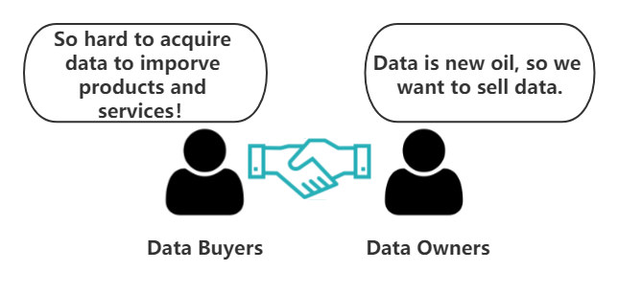
Personal Data Trading
Personal data is the new oil.
Companies need such oil to improve products and services.
Individuals don’t want to provide such oil for free.

Slide 5
Personal Data Trading
Two key issues in personal data trading:
Privacy protection
Data pricing
Notes:
My research is to investigate the theoretical model of personal data trading.
There are three parties in a personal data marketplace: data owners, data buyers, and a market maker.
Data owners contribute their personal data and get monetary compensations in return.
Data buyers request queries over the data and pay for query answers.
The market maker acts as a trustworthy intermediary.
She computes perturbed query answers, sets query price, and compensates data owners.
Since personal data reveal private information and are different from traditional products,
how to protect privacy and how to price data are the two key issues in personal data trading.

Slide 6
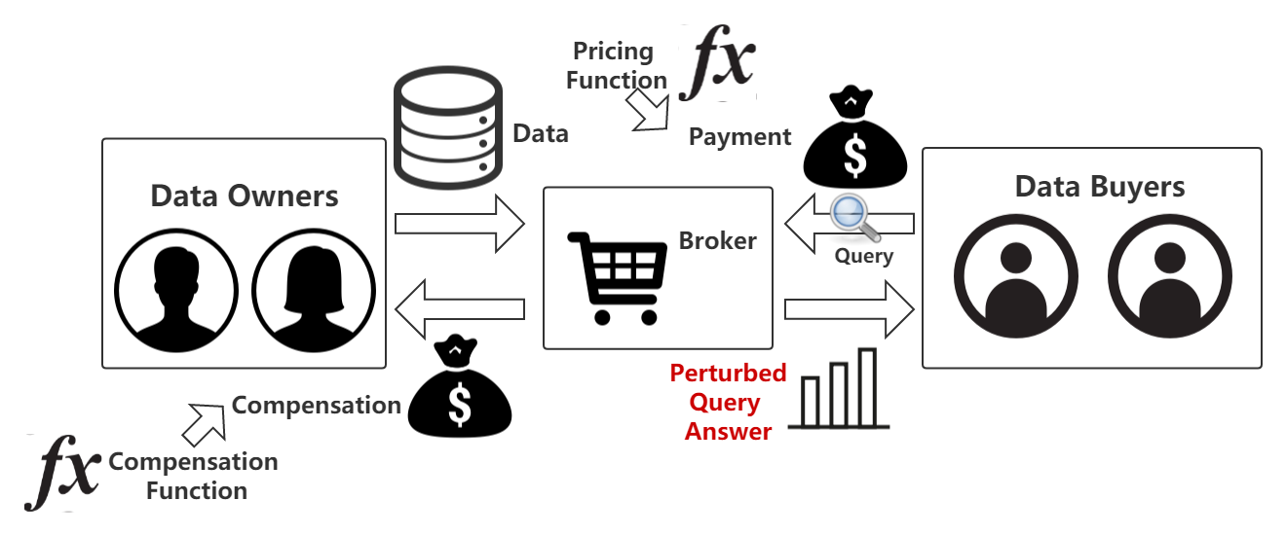
How to protect privacy?
Perturbation: previous works [1,2] protect privacy by adding noise into query answers.
Privacy loss $ε$: representing the protection level under differential privacy.
Data utility: the higher privacy loss, the higher utility.
Notes:
Previous works [1,2] preserve privacy via the perturbation technique differential privacy.
It means that the query answers are perturbed by some perturbation mechanism which satisfies the property of differential privacy.
In differential privacy, the perturbation mechanisms control the privacy protection level by a parameter, which we call individual privacy loss epsilon.
And under different levels, the data utilities of perturbed query answers are quite different.

Slide 7
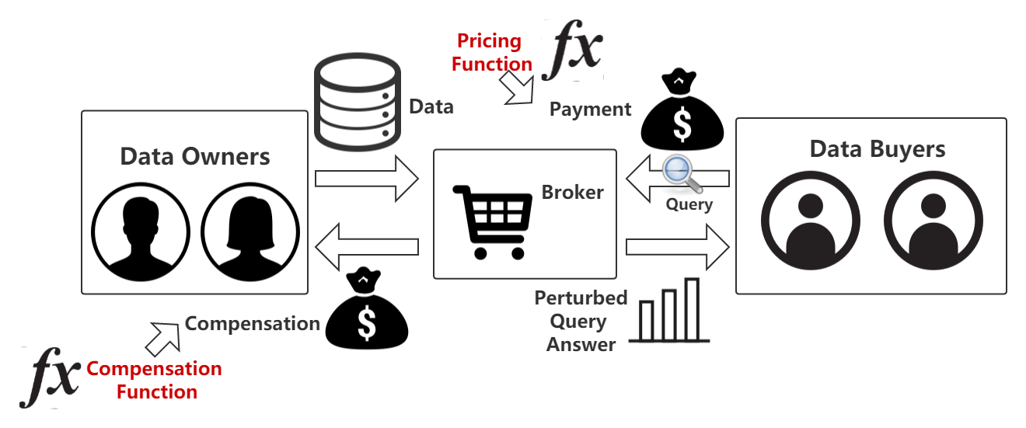
How to price data?
For data buyers: to price query answers by a pricing function of the utility (designed by the broker)
For data owners: to compensate each data owner by a compensation function of privacy loss (set by the data owner).
Personal data trading is essentially trading privacy loss for money
Notes:
Thus they proposed a method of pricing personal data.
That is the market maker sets query price by a pricing function of data utility, and compensates data owners by a compensation function of privacy loss.
And they proposed methods how to design a cost-covering and arbitrage-free pricing function, based on a particular perturbation mechanism, the Laplace mechanism.

Slide 8
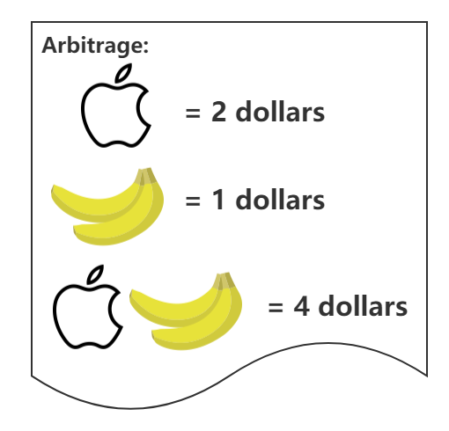
Requirements for Pricing Functions
Cost-covering: the price should cover the cost (the total compensations).
Arbitrage-free: the consistency of query prices.
Intuitively, a buyer should not obtain the answer to a query by deriving this answer from a less expensive set of queries.
Notes:
When designing a pricing function, we should at least guarantee it is cost-covering and arbitrage-free.
Cost-covering means the price should cover the total compensations to data owners.
Arbitrage-free intuitively means the consistency of query prices.
Here is an example in fruit marketplace.
The price of an apple is 2 dollars and the price of a banana is 1 dollar.
The problem is that the price of the combo of an apple and a banana is 4 dollars.
Then any rational buyer will never the combo because of the not arbitrage-free price.

Slide 9
Problems & Our Settings
Notes:
Then I will show the problems of previous works and introduce our settings.

Slide 10
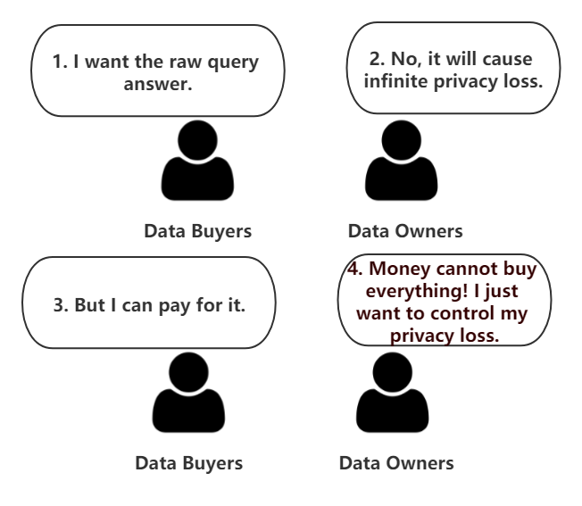
Existing Works Cannot Cover this Scenario
Notes:
In the previous works, the privacy losses can be infinite and are uniform for all data owners, which is not practical.

Slide 11
Problems of Previous Works
1. Privacy loss is not bounded.
Our survey reveals that most of data owners value privacy more important than the financial compensation when monetizing their data.
2. Uniform privacy losses for all data owners
Different data owners have different privacy preferences.
3. Only support static data
Large amounts of personal data, are generated continuously.
Notes:
First, a data buyer even can purchase raw data with infinitely high privacy loss as long as she could pay for it, which means data owners cannot control their privacy losses.
However, our survey reveals that most of the data owners valued privacy more important than the financial compensation.
Second, DP perturbation mechanisms enforce uniform privacy losses for all data owners.
However, different data owners have different privacy preference.
Third, they mainly focus on static data while a large amount of personal data are streaming data.

Slide 12
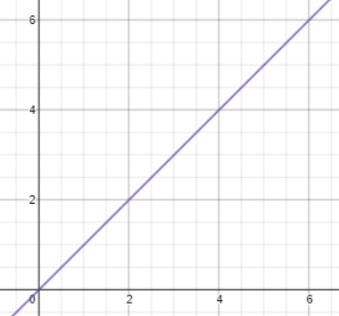
Our Settings: Trading Mobile Data with Controllable Privacy Loss
money
privacy loss
Uncontrollable privacy loss
Notes:
To solve these problems, in our settings, we let each data owner to set a upper bound of her privacy loss and use personalized differential privacy techniques to protect privacy. In this way, we make the total privacy loss controlled personally by data owners.

Slide 13
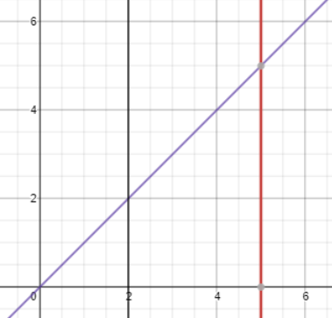
Our Settings: Trading Mobile Data with Controllable Privacy Loss
money
Owner 1’s upper bound
Owner 2’s upper bound
privacy loss
Controllable privacy loss
Notes:
To solve these problems, in our settings, we let each data owner to set a upper bound of her privacy loss and use personalized differential privacy techniques to protect privacy. In this way, we make the total privacy loss controlled personally by data owners.

Slide 14
Personalized Differential Privacy (PDP) [3] & W-Event Privacy [4]
Personalized differential privacy: privacy losses can be different
 | $$t=1$$ | $$t=2$$ | $$t=3$$ | …
Owner 1 | $$ε_{1}^{1}$$ | $$ε_{1}^{2}$$ | $$ε_{1}^{3}$$ | …
Owner 2 (w=2, upper bound =3) | $$ε_{2}^{1}=1$$ | $$ε_{2}^{2}=2$$ | $$ε_{2}^{3}=1$$ | …
Owner 3 | $$ε_{3}^{1}$$ | $$ε_{3}^{2}$$ | $$ε_{3}^{3}$$ | …
Owner 4 | $$ε_{4}^{1}$$ | $$ε_{4}^{2}$$ | $$ε_{4}^{3}$$ | …
 | $$D^{1}$$ | $$D^{2}$$ | $$D^{3}$$
W-event privacy: the total privacy loss in each window is bounded!
Personalized parameters:
Upper bound of the total privacy loss in a sliding window;
The size of the sliding window.
Notes:
And the personal data in our framework can be streaming data because we also use w-event privacy to bound the total privacy loss in any sequence of continuous data points of size w.
That means the upper bound of the total privacy losses in a sliding window and the window size are set by data owners.
For example, for the owner 2, the window size is 2, and the total privacy loss in the sliding window is bounded by 3.

Slide 15
Challenges
How to trade data in our settings?
1. Bounded utility: given a required utility, how to know whether it is answerable?
2. Personalized privacy losses: how to guarantee arbitrage-free pricing under a complex perturbation mechanism?
(The design of pricing function depends on the perturbation mechanism)
3. Privacy budget allocation: how to allocate privacy budgets while guaranteeing arbitrage-free pricing?
Notes:
Although the problems are related to privacy protection, the key issue still is how to design a cost-covering and arbitrage-free pricing function, which is more challenging in our settings.
First, because privacy loss is bounded, the utility of query answers is also bounded. The question is how to guarantee arbitrage-free pricing under bounded utility.
Second, as we said, the design of the pricing function depends on the utility function.
Under PDP perturbation mechanism, the utility function can be highly complicated, which makes it more difficult to design an arbitrage-free pricing function.
Third, as we also use w-event privacy as a constraint, it brings more complexity to the arbitrage-free pricing guarantee.
In conclusion, the challenge is we should guarantee arbitrage-free pricing under constraints from bounded utility, PDP, and w-event privacy.

Slide 16
Solutions
Notes:
Then, we introduce the solutions to our new problems.

Slide 17
Challenges
How to trade data in our settings?
1. Bounded utility: given a required utility, how to know whether it is answerable?
A new transaction workflow.
2. Personalized privacy losses: how to guarantee arbitrage-free pricing under a complex perturbation mechanism?
A general method for designing an arbitrage-free pricing function.
A theorem presenting the sufficient condition for arbitrage-free pricing
3. Privacy budget allocation: how to allocate privacy budgets while guaranteeing arbitrage-free pricing?
Arbitrage-free trading protocols satisfying the sufficient condition.
Notes:
Although the problems are related to privacy protection, the key issue still is how to design a cost-covering and arbitrage-free pricing function, which is more challenging in our settings.
First, because privacy loss is bounded, the utility of query answers is also bounded. The question is how to guarantee arbitrage-free pricing under bounded utility.
Second, as we said, the design of the pricing function depends on the utility function.
Under PDP perturbation mechanism, the utility function can be highly complicated, which makes it more difficult to design an arbitrage-free pricing function.
Third, as we also use w-event privacy as a constraint, it brings more complexity to the arbitrage-free pricing guarantee.
In conclusion, the challenge is we should guarantee arbitrage-free pricing under constraints from bounded utility, PDP, and w-event privacy.

Slide 18
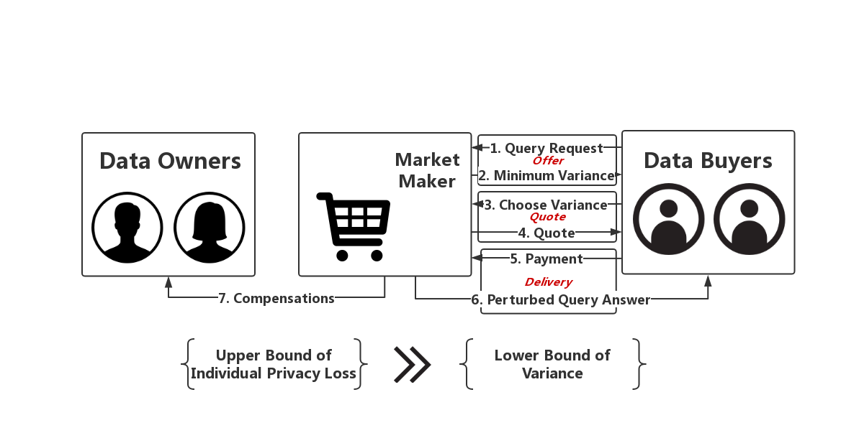
Solution: Transaction Workflow
Notes:
Because the utility is bounded, some utilities cannot be answered, which means the trading framework of previous works cannot fit our settings.
Thus we design a new framework with offer and quote phases, which means the buyer should ask the market maker the maximum utility she can request and choose a utility under the maximum one.

Slide 19
Solution: A General Method for Designing an Arbitrage-free Pricing Function
Step 1: to construct a pricing function based on the inverse function of the utility function.
Step 2: to guarantee some properties of the utility function, which results in arbitrage-free pricing.
Notes:
Then, we proposed a general method to design an arbitrage-free pricing function.
That is first we construct a pricing function based on the inverse function of the utility function and then we guarantee some properties of the utility function, which results in arbitrage-free pricing.

Slide 20
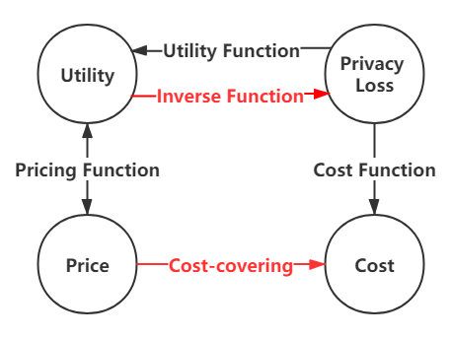
Step 1: Construct a pricing function based on the inverse function
We can utilize $\left[ε_{1},…,ε_{n}\right]=U^{−1}(v)$ to derive a cost-covering pricing function:
Consider each data owner $u_{i}$’s compensation is $μ_{i}\left(ε_{i}\right)=c_{i}⋅ε_{i}$
The pricing function is $π=Π\left(v\right)=\left[c_{1},…,c_{n}\right]⋅U^{−1}\left(v\right)=\sum_{i}{μ_{i}(ε_{i})}.$
Challenge: difficult to analyze whether the pricing function is arbitrage-free when the inverse function is too complex.
Notes:
Look at the graph, if we want to design a cost-covering pricing function, we should find a connection between the price and the cost.
Then if we use the inverse function of the utility function to design the pricing function, such cost-covering connection can be found.
That gave us the intuition that we can use the inverse function to derive a cost-covering pricing function by multiplying the compensation rates and the output of the inverse function together.
However, under PDP perturbation mechanisms, the inverse function might be too complicated to be expressed, which brings difficulty to analyzing whether the pricing function is arbitrage-free.

Slide 21
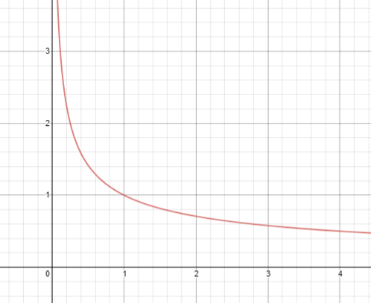
Step 2: Guarantee the Properties of the Utility Function for Arbitrage-free Pricing
Price
Properties of the pricing function =
Inverse properties of the utility function
Intuitively, an arbitrage-free pricing function should be a decreasing function, which means the higher variance, the lower price;
the price should decrease slowly as the variance increases, which means purchasing an accurate answer is more worthwhile;
the zero price corresponds to infinitely high variance.
Variance
Notes:
Then, because the properties of the pricing function are the inverse properties of the utility function, we consider whether we can study the properties of the utility function to guarantee arbitrage-free pricing.
Look at the graph, intuitively, an arbitrage-free pricing function should be a decreasing function and the price decreases slowly as the variance increases.
And of course the zero price corresponds to infinitely high variance.

Slide 22
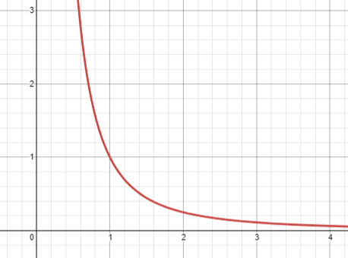
Step 2: Guarantee the Properties of the Utility Function for Arbitrage-free Pricing
Variance
Thus, the utility function should be a decreasing function, which means a higher variance corresponds to a lower price;
The variance should decrease rapidly as the privacy loss increases, so that the price will decrease slowly as the variance increases;
zero privacy loss corresponds to infinitely high variance.
Privacy Loss (Price)
Notes:
As the inverse, the utility function should be also a decreasing function but the variance decreases rapidly as the privacy loss increases.
And zero privacy loss corresponds to infinitely high variance.

Slide 23
Theorem of Arbitrage-free Pricing
Given a pattern $ρ$, the pricing function $π=Π_{M}\left(v\right)$ is arbitrage-free, if the utility function $v=U_{M}(ρ∗ε_{max})$ satisfies the following properties:
$∀ε_{max}>0$, $U_{ℳ}^{′}\left(ρ∗ε_{max}\right)<0$ （decreasing）
$∀ε_{max}>0$, $U_{ℳ}\left(ρ∗ε_{max}\right)U_{ℳ}^{′′}\left(ρ∗ε_{max}\right)≤2{\left(U_{ℳ}^{′}\left(ρ∗ε_{max}\right)\right)}^{2}$ （decreasing rapidly）
$\lim_{ε_{max}→0^{+}}{U_{ℳ}(ρ∗ε_{max})}=+∞$ （zero price->zero utility）
Notes:
Given the intuition, we propose the theorem of arbitrage-free pricing, which presents the sufficient condition where the utility function results in an arbitrage-free pricing function.

Slide 24
Solution: Two Arbitrage-free Trading Protocols
Based on our theorem, we design our trading framework with three key modules:
BudgetAlloc(): to allocate privacy budgets within the upper bounds;
BudgetAdusting(): to adjust privacy budgets to satisfy the sufficient condition for arbitrage-free pricing;
PerturbMech(); to perturb query answers.
Using different algorithms as instances of those modules, we propose two Trading protocols:
UniformTrading: the benchmark (privacy losses are uniform)
PersonalizedTrading: our advanced solution (privacy losses can be different).
Notes:
Based on our theorem, we know how to guarantee arbitrage-free pricing by guaranteeing the properties of the utility function, which is determined by the privacy protection process.
Thus we design our trading framework with three key module, to satisfy w-event privacy, arbitrage-free pricing, personalized differential privacy, respectively.
Then by using different algorithms as instances of those modules, we propose two Trading protocols.
UniformTrading is the classical solution in existing works but it can also fit our framework as the benchmark.
PersonalizedTrading is our advanced solution where the privacy losses can be different.

Slide 25
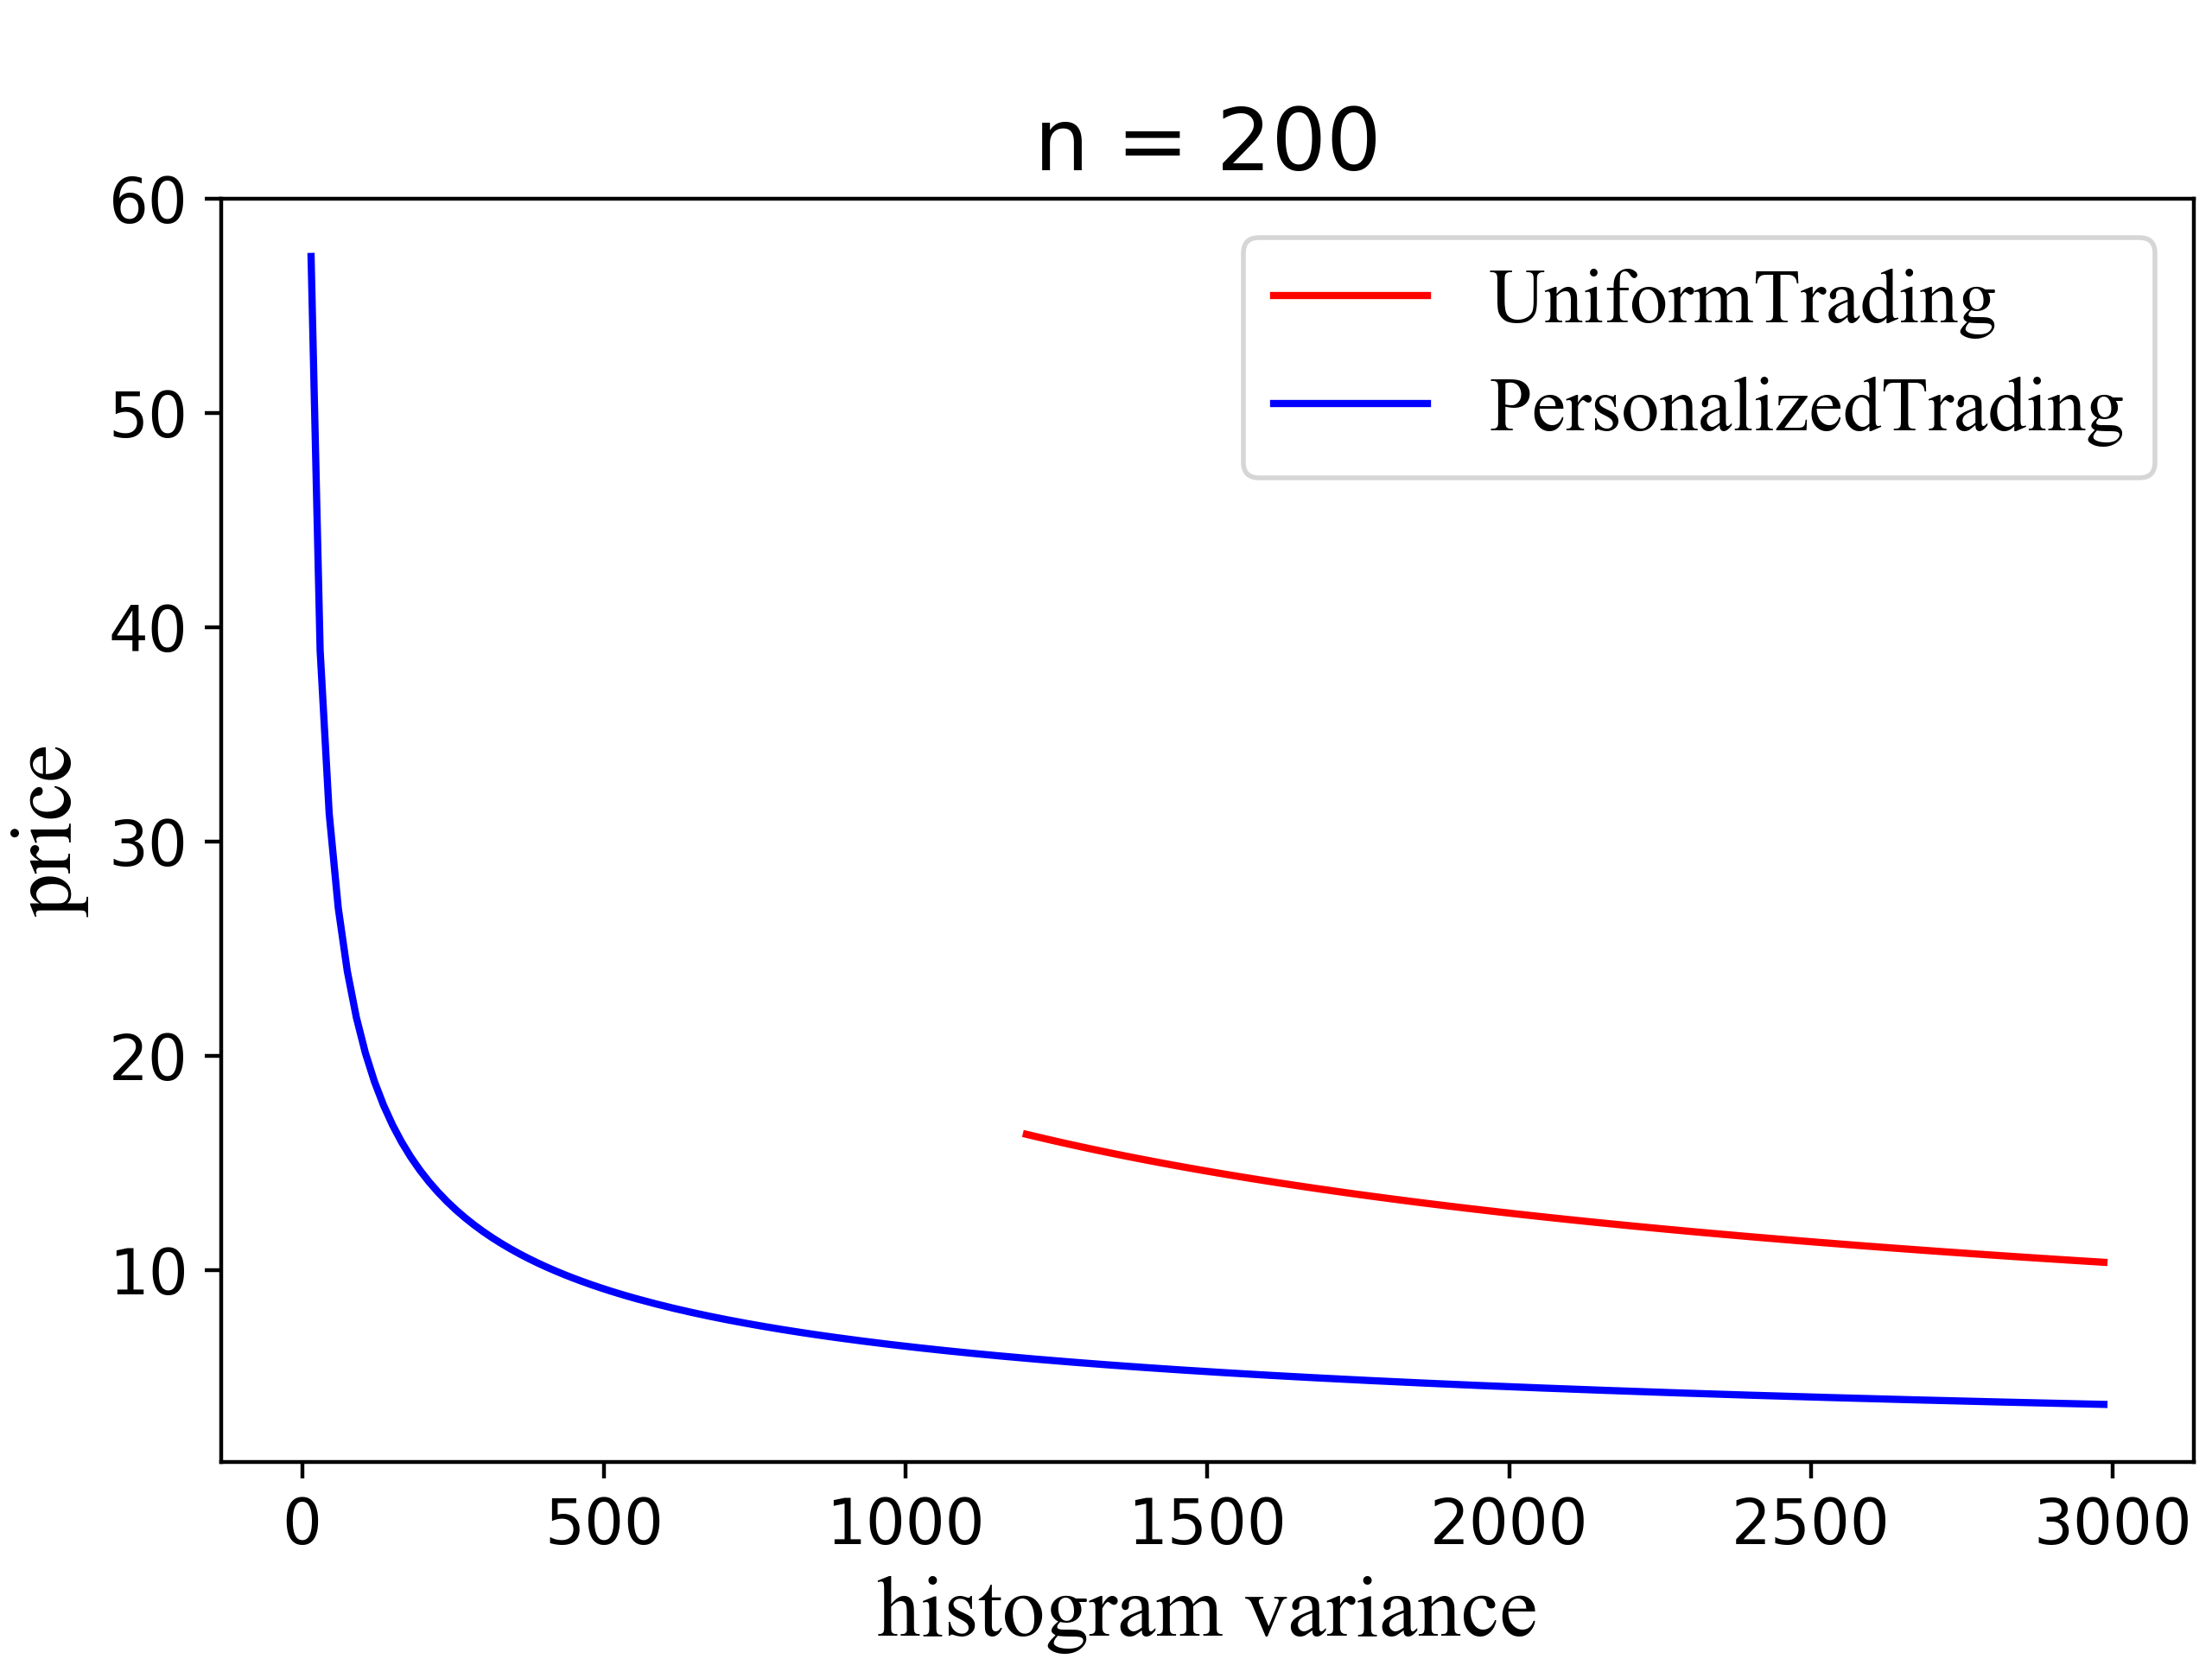
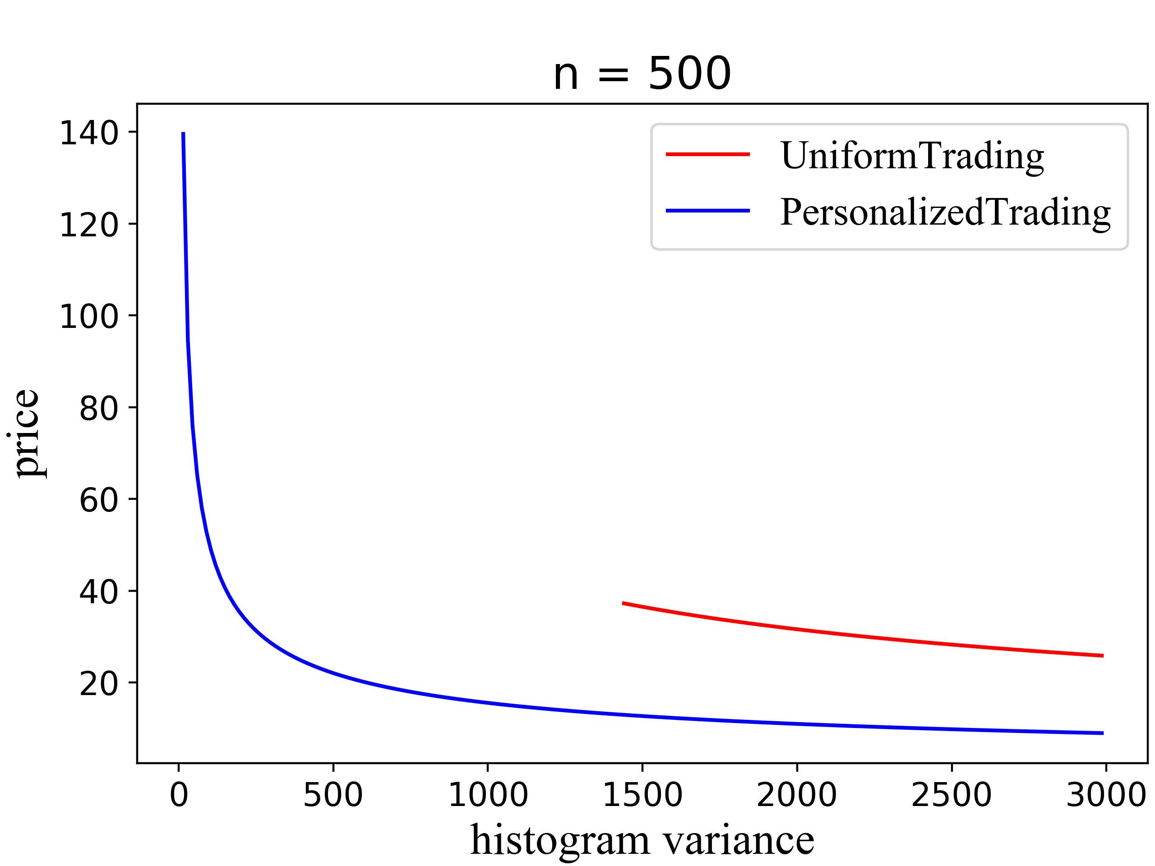
Experimental Results
Evaluation 1: Which protocol can provide more answerable queries?
Evaluation 2: Which protocol can provide a lower query price for the same utility?
Better cost-performance: for the same utility, the price is lower under PersonalizedTrading
More answerable queries: a wider range of utility can be requested under PersonalizeTrading
Notes:
Here is a part of experimental results.
We can see that our advanced solution outperforms the benchmark because for the same variance, the price in the advanced solution is much lower.
And a wider range of utilities can be answered in the advanced solution.

Slide 26
Conclusion
Setting: We empower data owners with the control of privacy loss.
Arbitrage-freeness: We propose a theorem showing the sufficient condition. Based on this theorem, we guarantee arbitrage-freeness by guaranteeing certain properties of the utility function.
Framework: Based on this theorem, we design an arbitrage-free framework for trading personal streaming data.
Protocol: Our advanced solution performs better in terms of cost-performance and making more queries answerable.

Slide 27
Reference
[1] C. Li, D. Y. Li, G. Miklau, and D. Suciu, “A theory of pricing private data,” ACM Transactions on Database Systems (TODS), vol. 39, no. 4, p. 34, 2014.
[2] C. Niu, Z. Zheng, F. Wu, S. Tang, X. Gao, and G. Chen, “Unlocking the value of privacy: Trading aggregate statistics over private correlated data,” in Proceedings of the 24th ACM SIGKDD International Conference on Knowledge Discovery & Data Mining. ACM, 2018, pp. 2031–2040.
[3] Z. Jorgensen, T. Yu, and G. Cormode, “Conservative or liberal? Personalized differential privacy,” in 2015 IEEE 31St international conference on data engineering. IEEE, 2015, pp. 1023–1034.
[4] G. Kellaris, S. Papadopoulos, X. Xiao, and D. Papadias, “Differentially private event sequences over infinite streams,” Proceedings of the VLDB Endowment, vol. 7, no. 12, pp. 1155–1166, 2014.

Slide 28
Thanks for Listening!

